Slide 1

Survival Analysis & GLMM
Lecture 8
LSM3257
AY22/23; Sem 2 | Ian Z.W. Chan

Slide 2

Advanced analyses – Analysis decision tree
(will be modified further)
Normally distributed (errors):
Regression^*
Not normally distributed (errors):
Generalised Linear Model (GLM) with error structure to be determined by you
Start
All Continuous
Response variable type
Continuous
Explanatory variables types
All Categorical
Normally distributed (response):
Analysis of variance (ANOVA)^*
Not normally distributed (response):
Kruskal-Wallis test or GLM
Categorical
Continuous and Categorical
Time to Death
Count
Number of categories
Normally distributed (response):
Analysis of covariance (ANCOVA)^*
Not normally distributed (response):
Rank-based ANCOVA (RANCOVA) or
GLM with error structure to be determined by you
Proportion
2
>2
GLM with Poisson errors (aka Poisson regression)
No
^Heteroscedasticity: use GLS
*Random effects: use LME
Overdispersion present?
GLM with Binomial errors (aka Binary Logistic regression)
Yes
Survival Analysis
GLM with Binomial errors (aka Logistic regression)
GLM with Quasi-Poisson errors or
GLM with Negative Binomial errors
GLM with Multinomial errors (aka Multinomial Logistic regression)

Slide 3
Summary (Learning Objectives)
Survival Analysis
- What it does, censoring and hazard functions
- Fitting, simplifying and interpreting: Gamma glm() and survreg()
- Plotting Kaplan-Meier curves using survfit() and autoplot()
Generalised Linear Mixed Models
- What is a GLMM?: error families, random errors and estimation methods
- Functions: glmer(), glmmPQL() and stan_glmer()
- Fitting and simplifying
- Solving errors

Slide 4
Survival Analysis

Slide 5
What is Survival Analysis?
A Survival Analysis models the time taken for an event to happen (e.g. death)
- Variance tends to increase exponentially with increasing values, data tends to be right skewed
- In some cases, it is equivalent to a GLM with an exponential or Gamma error distribution.
2 classes of survival models:
- Nonparametric: focuses on the individual and cannot make predictions for the future.
- Parametric: models the entire population and cane make predictions for the future—in ecology we are more interested in this.
Examples:
1) Predicting how long an animal will survive (number of days) based on its colour (categorical) and body mass (continuous).
2) Predicting how long it will take for a storm to happen (number of months) based on average sea surface temperature (continuous).

Slide 6
Censoring
Tells R that even though the datapoint stops, the event did not occur.
- R will treat the datapoint differently: it will use only the fact that the event had not occurred by that time to inform the model.
Most common examples of when you need to censor your data:
1) The experiment ends and the event did not occur (e.g. the specimen didn’t die).
2) There is a problem with the datapoint and it needed to be removed (e.g. unplanned experimental error or problem).
You will need to tell R which datapoints are censored (0), e.g. actually still alive, and which are not (1), e.g. really dead, when you do the analysis.
- “0”: don’t use this information
- “1”: use this information

Slide 7
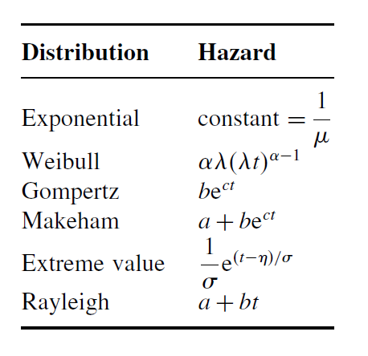
Survivorship and Hazard functions
Survivorship can be…
Type I: mortality rates increase with time (e.g. adult humans).
Type II: mortality rates are constant.
Type III: mortality rates decrease with time (e.g. fish over their life cycle).
We first choose different hazard functions to reflect these survivorships.
- Constant hazard: exponential distribution
- Hazard functions that vary with time…
Rayleigh: simplest, hazard increases linearly.
Makeham: most useful for humans.
Weibull: very flexible.
Loglogistic: consistently performs well.
We then compare the different models using AIC() to see which is best.

Slide 8
2 options to do a Survival Analysis
1) GLM with Gamma errors. Can only handle models with no censoring and constant hazard.
Uses glm() from Base R.
2) Parametric survival analysis. Can handle models with censoring and different hazard functions. We are more interested in this and I will be focusing on it.
Uses survreg() from the “survival” package.
Note: you could also do nonparametric survival analysis (we will not be covering this) using Cox proportional hazards models with coxph() from the “survival” package.
- This can handle models with censoring but not varying survivorship.
- The code is very similar but the interpretation of the results is different.

Slide 9
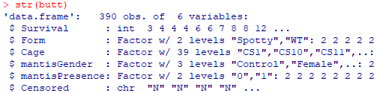
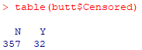
Example – Preparing the data
Let’s analyse how butterfly <Survival> (in days) is affected by how a butterfly looks <Form> in the presence of mantid predators <mantisPresence>. The <Cage> that the butterfly came from is a random effect.
Reading in the dataset
butt=read.table("buttSurvival.txt", header=T)
butt$Form=as.factor(butt$Form)
butt$Cage=as.factor(butt$Cage)
butt$mantisGender=as.factor(butt$mantisGender)
butt$mantisPresence=as.factor(butt$mantisPresence)
str(butt)
table(butt$Censored)

Slide 10
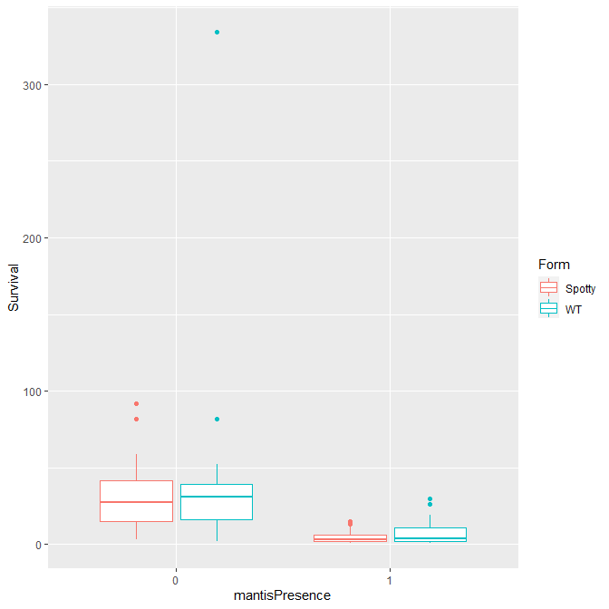
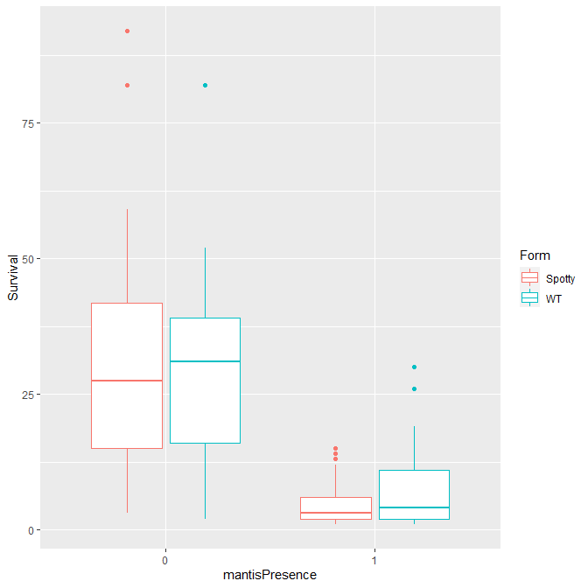
Example – Exploring the data
Notice how the data is very right skewed
Boxplots for quick comparison
ggplot(data=butt,aes(x=mantisPresence,y=Survival))+ geom_boxplot(aes(col=Form))
Quickly remove the extreme outlier (optional, up to you to decide if this is necessary) and replot
butt=butt[-which(butt$Survival>300),]
ggplot(data=butt,aes(x=mantisPresence,y=Survival))+ geom_boxplot(aes(col=Form))
As expected, when there are no mantid predators, butterflies survive longer and it looks like there’s no difference between Spotty and WT.
When there are predators, it looks like WT may survive longer than Spotty. However, this is not clear.

Slide 11
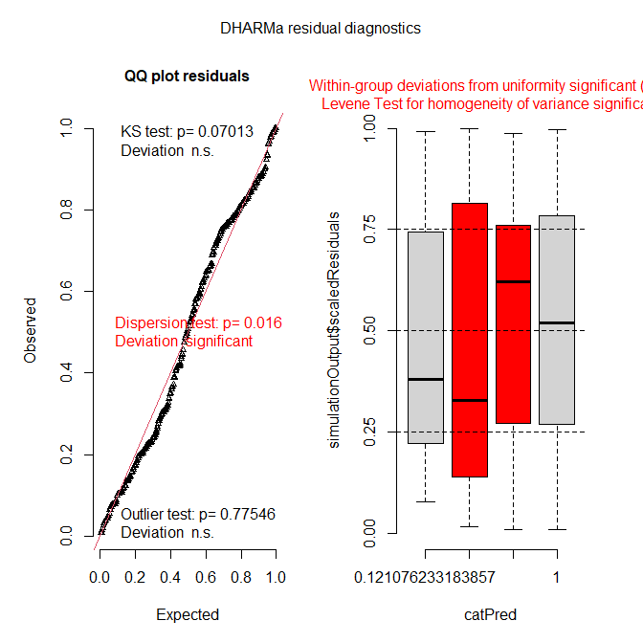
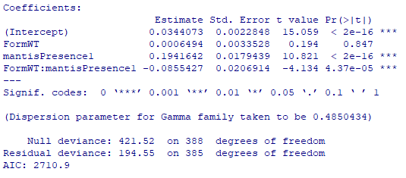
Example – Fitting a GLM with Gamma errors
Debugging Time!
Can you spot the error in this slide?
mod1.1=glm(Survival~Form*mantisPresence,family=gamma,data=butt)
#Diagnostics
require(DHARMa)
plot(simulateResiduals(mod1.1))
#View results
summary(mod1.1)
We could not include censoring or non-constant hazards, or a random effect because this is a GLM. These may be reasons for our problems.
Link function is inverse (check ?family), so to convert back to time survived, take the inverse of this value:
- Survival of Spotty = inverse of intercept (1/0.034).
- Survival of WT = 1/(0.0344+0.00065).
Gamma accommodates for overdispersion using a dispersion parameter, so don’t worry about this.
Can do model simplification using AIC()
Looks like there is a problem with equality of variance. We cannot use these results and will need to do the survival analysis another way.
Notes:
“family=gamma” should be “family=Gamma”

Slide 12
Example – Fitting a Parametric model
Make sure to code the <Censored> variable correctly: Not censored (i.e. use the data) = 1; Censored (i.e. don’t use the data) = 0
butt$Censored[butt$Censored=="N"]=1
butt$Censored[butt$Censored=="Y"]=0
butt$Censored=as.numeric(butt$Censored) #Must be logical or numeric
Fit the model
require(survival)
mod1.3=survreg(Surv(Survival,Censored)~Form*mantisPresence,cluster=Cage, data=butt,dist=“weibull")
Your explanatory variables. Can also use “+” for non-interacting or “/” for nesting.
This is the main function
Dataset
This is the “y-variable”. You have to use the Surv() function to create an object with your two variables for survival duration and censorship status.
Your “random effect”. Can only have 1 in survreg() models. So if you have multiple random effects, you could create a variable that reflects all of them using paste() though this is not ideal.
Hazard function is specified using the “dist=” argument. If none is provided, Weibull is used by default.

Slide 13
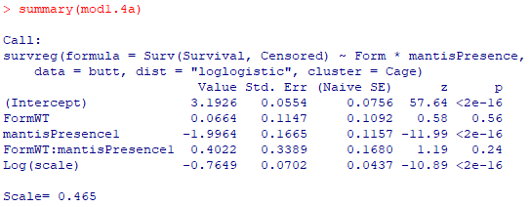
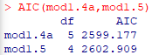
Example – Fitting a Parametric model
Fit other hazard functions and compare using AIC
mod1.4a=survreg(Surv(Survival,Censored)~Form*mantisPresence,cluster=Cage, data=butt,dist="loglogistic")
mod1.4b=survreg(Surv(Survival,Censored)~Form*mantisPresence,cluster=Cage, data=butt,dist="exponential")
AIC(mod1.3,mod1.4a,mod1.4b) #mod1.4a best
Note: Distributions available in survreg(): "extreme", "gaussian", "logistic", "t", "loggaussian", "loglogistic", "rayleigh", "exponential" and "weibull" (the default)
Proceed with <mod1.4a> for simplification
summary(mod1.4a) #interaction non-significant
mod1.5=update(mod1.4a,~.-Form:mantisPresence)
AIC(mod1.4a,mod1.5) #mod1.4a is better, so we keep the interaction
Note that Scale < 1: this indicates that hazard decreases with time

Slide 14
Example – Fitting a Parametric model
Interpret results
summary(mod1.4a)
Average Spotty (the reference <Form>) survival = e^{3.1926} = 24.4 days
Average WT survival = e^{(3.1926+0.0664)} = 26.0 days
Average survival of Spotty in the presence of mantids = e^{(3.1926-1.9964)} = 3.3 days
Average survival of WT in the presence of mantids = e^{(3.1926-1.9964+0.4022)} = 4.9 days

Slide 15
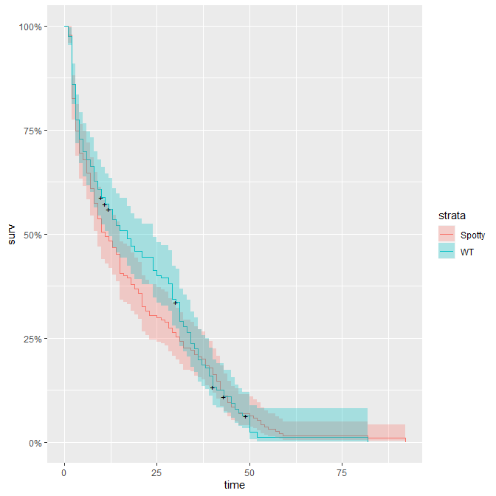
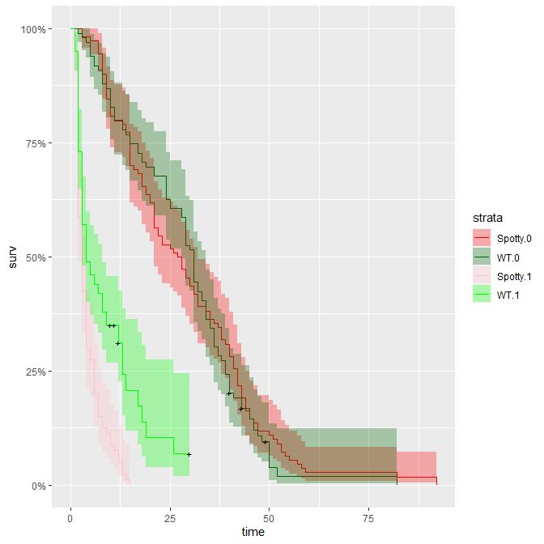
Example – Plotting a Kaplan-Meier survival curve
“+” denotes places where a datapoint was censored
Plot the data
require(ggfortify) #for autoplot
#For 1 variable
splot1=survfit(Surv(Survival,Censored)~Form,data=butt)
autoplot(splot1)
#For 2 variables
splot2=survfit(Surv(Survival,Censored)~ interaction(Form,mantisPresence),data=butt)
autoplot(splot2)
Even though the interaction was non-significant, from the plots we can see it has an important effect: be careful of following p-values blindly
Can add more variables if you want: “interaction(xv1,xv2,xv3)”
There is no difference between Spotty and WT when mantids are absent
There’s a clear difference between Spotty and WT when mantids are present

Slide 16
GLMM
Generalised Mixed (effects) Linear Models

Slide 17
Advanced analyses – Analysis decision tree
(will be modified further)
Normally distributed (errors):
Regression
Not normally distributed (errors):
GLM with error structure to be determined by you†
Start
All Continuous
Response variable type
Continuous
Explanatory variables types
All Categorical
Normally distributed (response):
Analysis of variance (ANOVA)
Not normally distributed (response):
Kruskal-Wallis test or GLM†
Categorical
Continuous and Categorical
Time to Death
Count
Number of categories
Normally distributed (response):
Analysis of covariance (ANCOVA)
Not normally distributed (response):
Rank-based ANCOVA (RANCOVA) or
GLM with error structure to be determined by you†
Proportion
2
>2
GLM with Poisson errors† (aka Poisson regression)
No
Overdispersion present?
GLM with Binomial errors† (aka Binary Logistic regression)
Yes
Survival Analysis
GLM with Binomial errors† (aka Logistic regression)
GLM with Quasi-Poisson errors† or
GLM with Negative Binomial errors†
GLM with Multinomial errors† (aka Multinomial Logistic regression)
†Random Effects: use GLMM.

Slide 18
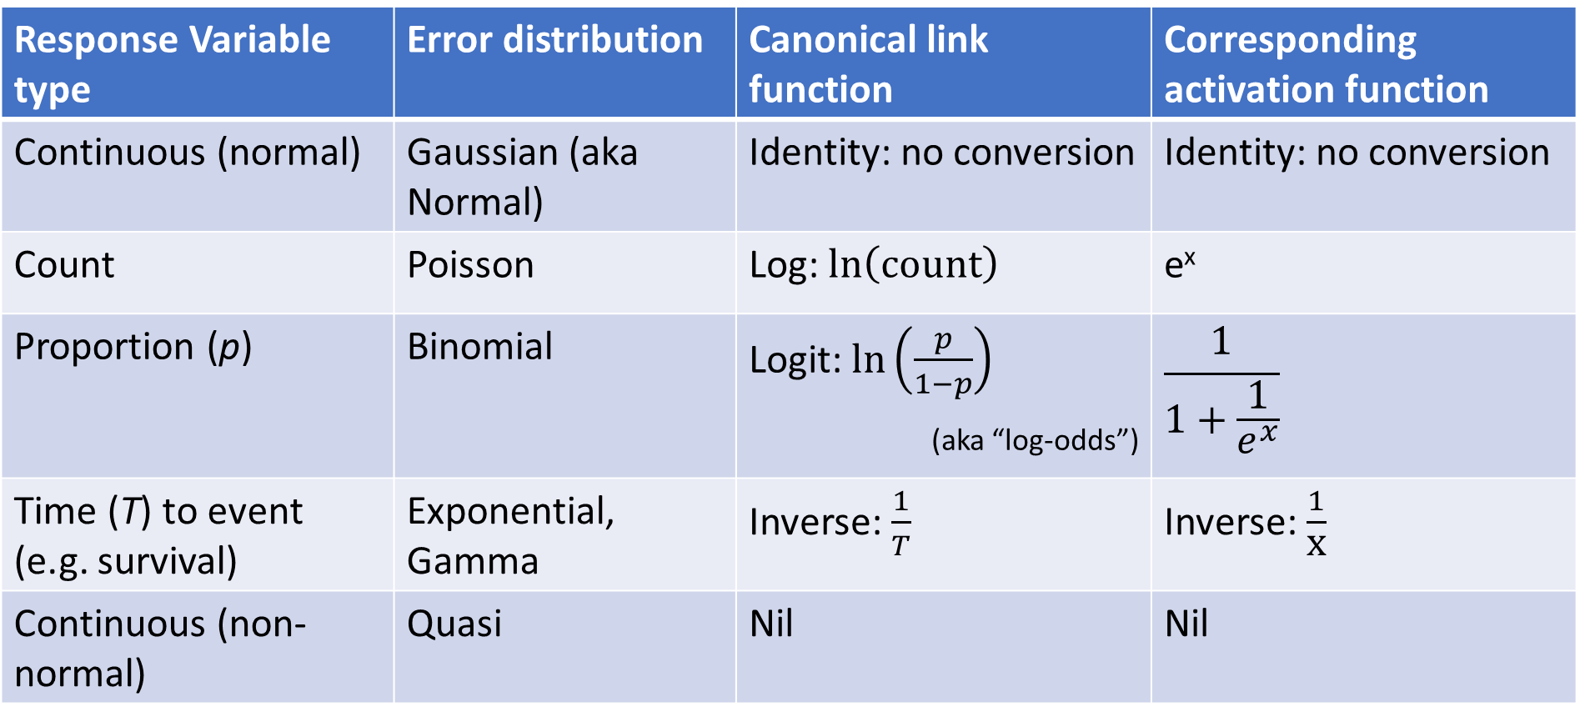
What is it?
Generalised Liner Mixed-effect Models are exactly like GLMs (you just need to specify the correct error distribution for your variable type).
Recall:
Except that GLMMs can also include random effects!!
Nice symmetry:
LM + Random Effects = LME
GLM + Random Effects = GLMM

Slide 19
Are they God’s greatest gift to ecologists for doing stats?—Yes! Well, maybe.. Hmm, not quite.
Flexible: can model many different types of data. [Yes!]
- Continuous, counts, proportions, etc.
Powerful: they can also account for random effects. [Yes Yes Yes Yes Yes!!]
Problematic: “Convergence errors” are frequently encountered. [oh, well maybe]
- Try to keep your models simple and your sample size large.
They are new: many aspects are still being developed, there are many “rules” and best practices are still changing—making it very confusing. [hmm.. not quite]
- Examples: REML is not possible, quasipoisson and quasibinomial families were previously OK but are now not recommended.
- You will run into errors, BE BRAVE and experiment!

Slide 20
4 main Likelihood estimation methods
1) Penalised Quasi-likelihood (PQL). Estimates quasi-likelihood. This was the most widely used. However, it is sometimes unreliable, especially when the standard deviations of the random effects are large, with binary data, etc.
2) Laplace. Estimates true likelihood. More reliable than PQL but more computationally intensive.
3) Gauss-Hermite quadrature (GHQ). Even more reliable and computationally intensive, hence cannot handle more than 1 random effect.
4) Bayesian using MCMC. This is used in a Bayesian framework and can handle many random effects, but is the most computationally intensive.
For more information: Bolker et al. (2009). Generalized Linear Mixed Models: a practical guide for ecology and evolution. Trends in Ecology and Evolution 24(3):127-135. (Ben Bolker is huge in the field, you see him in stats-exchange)
MCMC (Markov chain Monte Carlo) is a way of getting values by repeated trial and error.

Slide 21
Fitting a GLMM – 3 different packages for different occasions
1) glmmPQL()from the “MASS” package—uses PQL.
- Pros: can fit variance structures (based on “nlme”), uses quasi-families automatically for overdispersion.
Cons: not good for multiple random effects, no AIC(), no diagnostics, less reliable in some cases.
General code:
require(MASS)
modelObject=glmmPQL(Y~X1*X2+X3/X4,random=~X5|X6/X7,family=poisson, data=dataset,weights=vs1)
Function to fit GLMM
Error distribution. Because this is glmmPQL(), this is automatically quasipoisson. “family=binomial” would be quasibinomial.
Fixed effects. Can contain interacting, non-interacting and nested variables
Random effects. Can contain random slope and intercept, and nested variables, but not good for multiple independent random effects (aka “crossed random effects”)
Name of dataframe object containing all the variables to be used
Variance structure. Needs to be predefined before this, same as with gls()

Slide 22
Fitting a GLMM – 3 different packages for different occasions
2) glmer() from the “lme4” package (same as lmer())—uses Laplace or GHQ.
- Pros: more reliable, can fit multiple random effects and use AIC().
- Cons: cannot deal with overdispersion for binomial distributions.
General code:
require(lme4)
modelObject=glmer(Y~X1*X2+X3/X4+(1|X6/X7)+(X8|X9),family=poisson,nAGQ=1, data=dataset)
Separate function for negative binomial error distribution:
modelObject=glmer.nb(Y~X1+(X2|X3),nAGQ=1,data=dataset)
Error distribution. Can take poisson, binomial, Gamma, gaussian, but NOT quasipoisson and quasibinomial. Note that negative binomial is run using a different function
Function to fit GLMM
Fixed effects. Can contain interacting, non-interacting and nested variables
Random effects. Can contain random slope and intercept, nested variables and multiple independent random effects
This controls whether Laplace (nAGQ=1) or GHQ (nAGQ=2) estimation is used.
- If you set nAGQ=0, you get something similar to PQL. Default is nAGQ=1, so you can omit this command if you want to use Laplace (which I normally do).
- Note that for GHQ, you can only have one random intercept (aka scalar) random effect (i.e. no random slope, no multiple random effects and no nesting).
Name of dataframe object containing all the variables to be used
For negative binomial, only the function is different, all the other commands are the same (but no need to specify “family=“)

Slide 23
Fitting a GLMM – 3 different packages for different occasions
3) stan_glmer() from the “rstanarm” package—uses MCMC.
- Pros: powerful—can take multiple explanatory variables and random effects with interactions, nesting, random slopes and intercepts, etc.
- Cons: no quasi-families, takes a long time, harder to become expert.
General code (similar to glmer()):
require(rstanarm)
modelObject=stan_glmer(Y~X1*X2+X3/X4+(1|X6/X7)+(X8|X9),family=poisson, QR=T,data=dataset)
Separate function for negative binomial error distribution:
modelObject=stan_glmer.nb(Y~X1+(X2|X3),data=dataset)
MCMCglmm used to be the default package/function for doing GLMMs using Bayesian estimation. However, its documentation is notoriously poor and you MUST define priors (something to do with Bayesian stats which I will briefly cover, this is complicated to learn).
With stan_glmer(), the rstanarm package uses default priors for the error distribution you specify. In an ideal world, you should learn how to define your own priors (I will not teach this) but it is still OK to use the defaults for a start.
Function to fit the GLMM
Fixed effects. Can contain interacting, non-interacting and nested variables
Random effects. Can contain random slope and intercept, nested variables and multiple independent random effects
Error distribution. Can take poisson, binomial, Gamma, gaussian, but NOT quasipoisson and quasibinomial. Similar to glmer(), negative binomial is run using a different function
“QR” defaults to F. You can choose to set to T if you have more than 1 explanatory variable. Does not change results; just improves the computation
No need to specify error distribution here

Slide 24
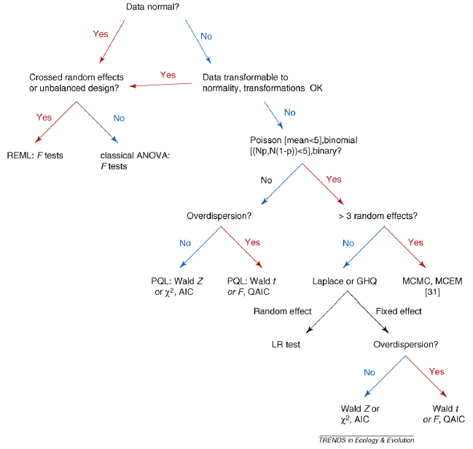
When to use what?: Bolker’s decision tree
3 main decision points…
A: If you have: (i) Poisson where mean < 5; (ii) proportion where the number of successes or failures < 5; or (iii) binary data, do not use PQL.
B: If you have > 3 random effects, use MCMC.
C: When using Laplace/GHQ, if you have overdispersion, use Quasi-AIC.
A
stan_glmer()
lme()
B
lm()
glmmPQL()
C
glmer()
Source: Bolker et al. (2009). Generalized Linear Mixed Models: a practical guide for ecology and evolution. Trends in Ecology and Evolution 24(3):127-135.

Slide 25
When to use what?: My personal procedure
Binary data and overdispersion
- Recall that the binomial distribution is used to fit 2 kinds of data: proportions and binary.
- It has long been accepted that proportion data can be overdispersed but binary data cannot. Therefore, with binary data, even if residual deviance > d.f, people usually just ignore it.
- However, recently there have been arguments that both proportion and binary data CAN be overdispersed. If this is true, you should still switch to quasibinomial if your binary data shows overdispersion.
- My advice: try both.
1) Start with using glmer().
2) Check for overdispersion. If there is overdispersion:
For Gamma data: it is OK.
For Poisson data: switch to glmer.nb() or glmmPQL().
For binomial data:
If your data is binary: do both glmer() and glmmPQL(family=binomial) and compare the results (see boxed text).
If your data is proportion:
If either the number of successes or failures < 5: do both glmer() and glmmPQL(family=binomial) and compare the results.
If both > 5: switch to glmmPQL(family=binomial).
3) If you have variance structures (see GLS lecture), fit using glmmPQL().
4) If you have very complex explanatory variables and error structures (and keep running into convergence errors): switch to stan_glmer().

Slide 26
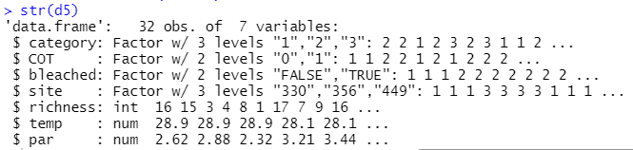
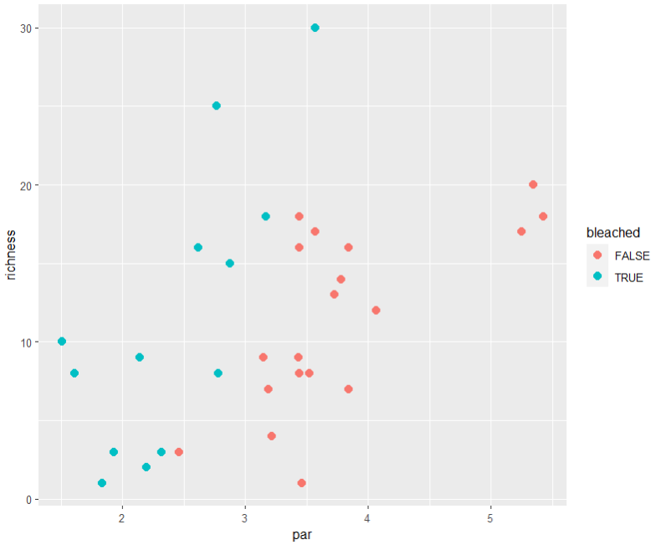
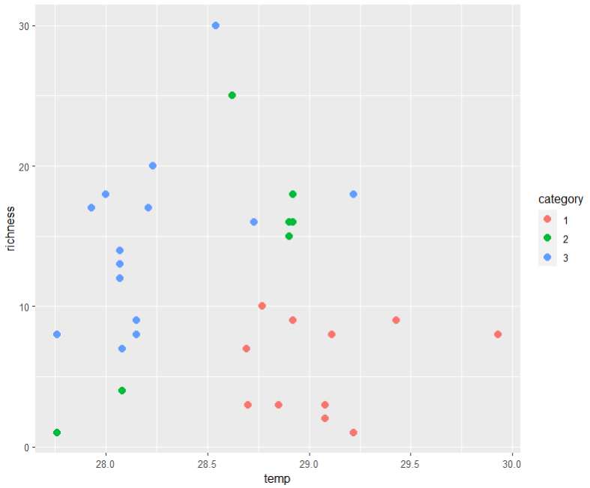
Example – Preparing the data
Fixed effects
Reading in dataset:
d5=read.csv("ReefData.csv")
d5$category=as.factor(d5$category)
d5$bleached=as.factor(d5$bleached)
d5$site=as.factor(d5$site)
d5$COT=as.factor(d5$COT)
Response variable <richness> is a count
Visualising fixed effects <par> and <bleached>:
ggplot(d5,aes(x=par,y=richness))+geom_point(aes(col=bleached),size=3)
Visualising random effects <temp> and <category>:
ggplot(d5,aes(x=temp,y=richness))+geom_point(aes(col=category),size=3)
32 observations for 7 variables is a little low: watch out for convergence errors!
But we are only interested in <par> and <bleached> so these are our fixed effects.
We use random effects to control for <temp> and <category>.
It looks like there is some pattern for all 4 variables: <par>, <bleached>, <temp> and <category>.
Random effects

Slide 27
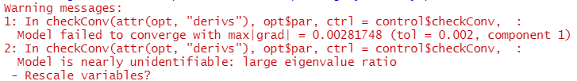
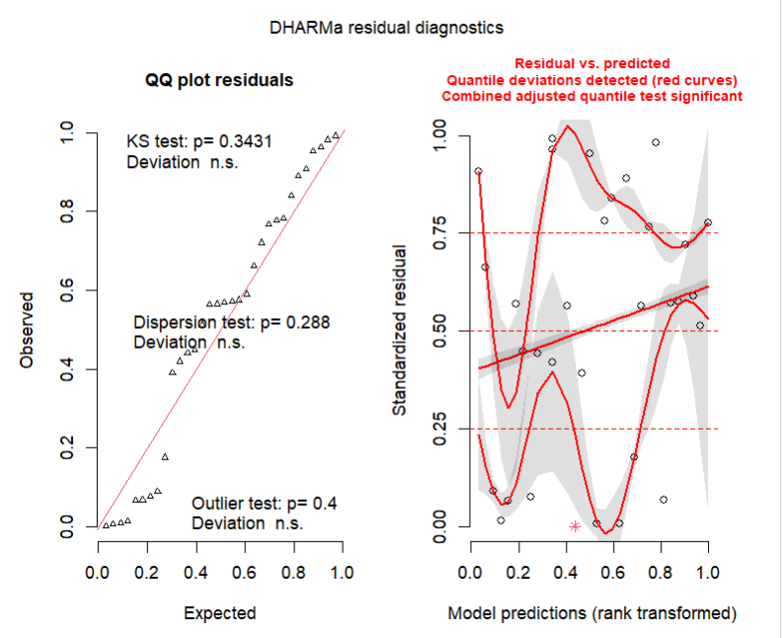
Example – Fitting the GLMM
Compared to LME
- Recall with LME, we used REML to simplify the random effects and then ML to simplify the fixed effects. This is not needed for GLMMs (there are arguments about whether REML makes sense here).
- It used to be doable in glmer()—you could previously specify “REML=T” or “REML=F”—but Ben Bolker has changed this.
Using glmer():
require(lme4)
mod2.1=glmer(richness~par*bleached+(temp|category),family=poisson,data=d5)
#Warnings you may see: “Model failed to converge”, “Model is nearly unidentifiable”. Let’s try to simplify by removing <temp>.
“Simplify” random effects first:
mod2.2=glmer(richness~par*bleached+(1|category),family=poisson,data=d5)
Test assumptions:
require(DHARMa)
plot(simulateResiduals(mod2.2))
No overdispersion but crazy problems with residuals.

Slide 28
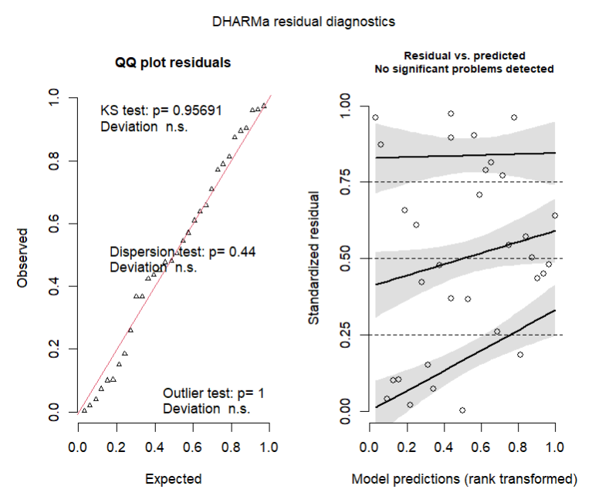
Example – When there is overdispersion and/or other problems
Debugging Time!
Can you spot the error in this slide?
We would need to use either a quasipoisson or negative binomial distribution.
To do a quasipoisson we would use glmmPQL, but we first need to make sure the mean of <richness> is at least 5 (look at Bolker’s decision tree).
mean(d5$richness) #11.4, so either PQL or negative binomial are fine
Try a negative binomial first, we use glmer.nb():
mod2.2a=glmer.nb(richness~par+bleached+(1|category),data=d5)
plot(simulateResiduals(mod2.2a)) #solved!
If not solved, we could switch to quasipoisson:
mod2.2b=glmmPQL(richness~par+bleached,
random=~1|category,family=quasipoisson, data=d5)
Notes:
“family=quasipoisson” should be “family=poisson”

Slide 29
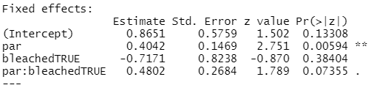
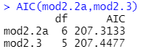
Example – Simplifying
Current practices for simplifying GLMMs
- We don’t really simplify Random Effects. We choose them based on our experimental design. During analysis, we may choose to “simplify” the Random Effects to solve convergence problems.
- To compare fixed effects in models, we use…
For non-quasi models: AIC or anova(test="chisq")
For quasi models: there is currently no test to compare models fit using glmmPQL, we just have to rely on the p-values (read this).
summary(mod2.2a) #interaction: P = 0.073
mod2.3=update(mod2.2a,~.-par:bleached)
AIC(mod2.2a,mod2.3)
Always go back to the data and the biological intuition. Is there an interaction? It looks like there is no interaction, so I simplify:
summary(mod2.3)
#Both <par> and <bleached> are now significant, this is my final model

Slide 30
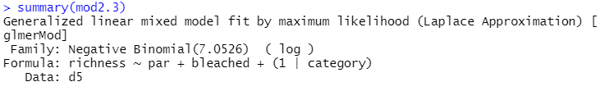
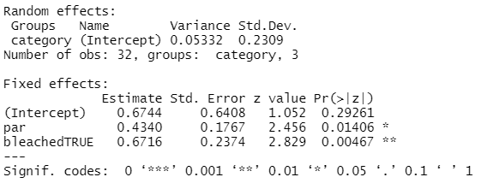
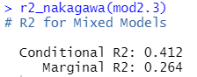
Example – Interpreting
Recall this is the link function, so to convert the effect sizes from the units of the linear predictor (reported as the “Estimate”), we need to take e^{Estimate}.
summary(mod2.3)
exp(summary(mod2.3)$coef[1,1]+summary(mod2.3)$coef[2,1]) #for <par>
exp(0.67844+0.6716)
Calculate proportion of variance explained by fixed vs. random effects
require(performance)
r2_nakagawa(mod2.3)
Amount of variance explained by the random effect <category>. Not easy to compare this to the amount explained by the fixed effects directly (need another function below).
Proportion of total variation explained by fixed and random effects combined
Proportion of total variance explained by fixed effects alone

Slide 31
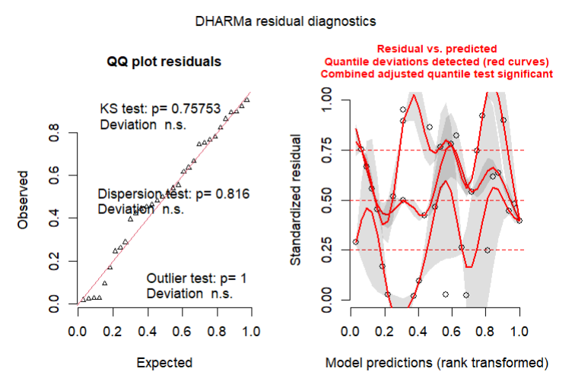
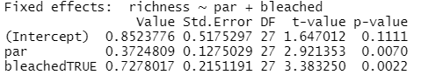
Example – model checking
Check the final model:
require(DHARMa)
plot(simulateResiduals(mod2.2b))
Looks like we still might need to switch to quasipoisson in the end:
mod2.3b=glmmPQL(richness~par+bleached,random=~1|category,family=poisson, data=d5)
summary(mod2.3b)
Result is qualitatively the same (i.e. both variables are significant) but effect sizes are slightly different. This gives me more confidence in the results.

Slide 32
A note on multinomial GLMMs
There is no good and easy way to fit multinomial GLMMs as yet.
Option 1: Fit a multinomial GLM, i.e. with everything (including your desired random effects) as fixed effects. Use this to assess whether your “random effects” are important and decide whether or not to keep them in the model.
Option 2: If you really want to do a GLMM, you can try the npmlt() function from the “mixcat” package. But it is not yet well established (and slightly compliated).

Slide 33
Dealing with errors
Common errors: “Iteration limit reached”, “Failed to Converge”, “Singular fit”, “Maximum number of evaluations reached”, etc.
Mostly because you have too many random (or even fixed) effects for your N
Your model is too complex for your N (interactions, random slopes, etc.)
Strategies to fix the errors:
1) Gather more data to increase the N! =)
2) Simplify your random effects if possible (or fixed effects too, but this is often linked to your research question so less likely).
3) Use a different function from other packages: e.g. glmmADMB, glmmML, MCMCglmm, etc. (Bayesian methods are able to avoid these errors if your prior is meaningful).
4) Change optimiser settings. These affect things like how many times R repeats its trial and error before stopping, its starting values, the algorithm used, etc.

Slide 34
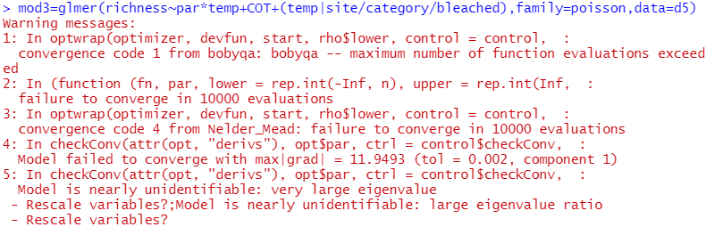
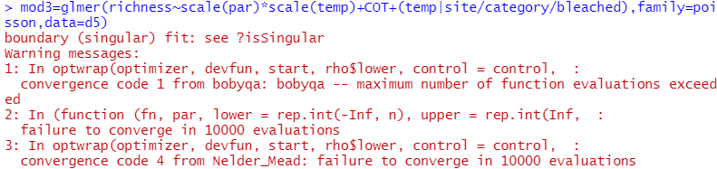
Dealing with errors – Scaling variables
We are trying to fit this super complex model:
mod3=glmer(richness~par*temp+COT+(temp|site/category/bleached),family=poisson,data=d5)
Let’s try to fix the (easier) warning about the need to scale variables:
mod3.1=glmer(richness~scale(par)*scale(temp)+COT+(temp|site/category/bleached),family=poisson,data=d5)
Convergence errors
Calculation anomaly, caused by continuous variables that have very different ranges of values. Here mean <par> is 3.2 and mean <temp> is 28.6: a difference of one order of magnitude
Command to scale variables: converts variables to a mean of 0 and a S.D. of 1. But careful with interpretation if you do this. You could avoid this step by just simplifying your model.
Solved the Scale warning, but there are still convergence errors

Slide 35
Dealing with errors – Adjusting control settings
Try turning off “calc.derivs”:
mod3.2=update(mod3.1,control=glmerControl(calc.derivs=F))
Try decreasing tolerance levels (decreases number of trials needed):
mod3.3=update(mod3.1,control=glmerControl(optCtrl=list(FtolAbs=1e-10)))
Try changing optimizers:
mod3.4=update(mod3.1,control=glmerControl(optimizer="bobyqa"))
Note: other optimizers include "Nelder_Mead", "optim", "optimx", "nlminbwrap", "nloptwrap", "nmkbw". Some require you to install other packages.
None of these work: there are still convergences errors!

Slide 36
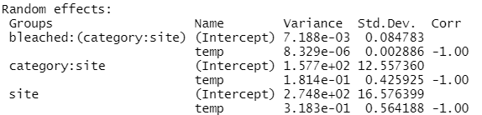
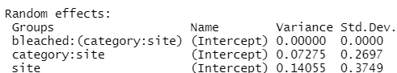
Dealing with errors – Adjusting optimiser settings
This is the maximum number of tries R is allowed to fit a model: it might take some time to run. Some optimizers (e.g. optim and optimx) use “maxit” instead of “maxfun”.
Try allowing more trials:
mod3.5=update(mod3.1,control=glmerControl(optimizer="bobyqa", optCtrl=list(maxfun=2e5)))
The only error left is “boundary fit”: this is not necessarily bad. It usually means one of your variables is not useful. In this case <temp> followed by bleached>.
mod3.6=glmer(richness~scale(par)*scale(temp)+COT+
(1|site/category/bleached),family=poisson,data=d5,
control=glmerControl(optimizer="bobyqa",optCtrl=list(maxfun=2e5)))
mod3.7=glmer(richness~scale(par)*scale(temp)+
COT+(1|site/category),family=poisson,data=d5,
control=glmerControl(optimizer="bobyqa",optCtrl=list(maxfun=2e5)))
Fixed! No more errors! Hooray!
mod3.5
<temp> removed
A perfect correlation may mean one of the variables is not needed. It also (normally) doesn’t make sense to have the same variable (<temp>) as both a fixed AND random effect.
<bleached> is not helping to explain any variation
<bleached> removed
mod3.6

Slide 37
Dealing with errors – Adjusting optimiser settings
But note that running this simpler model using default settings also runs fine:
mod3.8=glmer(richness~scale(par)*scale(temp)+COT+(1|site/category), family=poisson,data=d5)
So if you can, always try to simplify your random effects first! If this doesn’t work THEN try to adjust settings.
For more information, read:
https://bbolker.github.io/mixedmodels-misc/glmmFAQ.html#convergence-warnings
Run “?convergence” in R.

Slide 38
Summary (Learning Objectives)
Survival Analysis
- What it does, censoring and hazard functions
- Fitting, simplifying and interpreting: Gamma glm() and survreg()
- Plotting Kaplan-Meier curves using survfit() and autoplot()
Generalised Linear Mixed Models
- What is a GLMM?: error families, random errors and estimation methods
- Functions: glmer(), glmmPQL() and stan_glmer()
- Fitting and simplifying
- Solving errors

Slide 39
Advanced analyses – Analysis decision tree
(Final Version)
Normally distributed (errors):
Regression^*
Not normally distributed (errors):
GLM with error structure to be determined by you†
Start
All Continuous
Response variable type
Continuous
Explanatory variables types
All Categorical
Normally distributed (response):
Analysis of variance (ANOVA)^*
Not normally distributed (response):
Kruskal-Wallis test or GLM†
Categorical
Continuous and Categorical
Time to Death
Count
Number of categories
Normally distributed (response):
Analysis of covariance (ANCOVA)^*
Not normally distributed (response):
Rank-based ANCOVA (RANCOVA) or
GLM with error structure to be determined by you†
Proportion
2
>2
GLM with Poisson errors† (aka Poisson regression)
No
^Heteroscedasticity: use GLS
*Random effects: use LME
Overdispersion present?
GLM with Binomial errors† (aka Binary Logistic regression)
Yes
Survival Analysis
GLM with Binomial errors† (aka Logistic regression)
GLM with Quasi-Poisson errors† or
GLM with Negative Binomial errors†
GLM with Multinomial errors† (aka Multinomial Logistic regression)
†Random Effects: use GLMM.

Slide 40


Teaser for next week…
Biodiversity
To compare the biodiversity in Forest 1 vs. Forest 2,
we have
4 response
variables…
We’re going to need Multivariate Analyses!
 | Sp. 1 | Sp. 2 | Sp. 3 | Sp. 4
Site 1 | 7 | 8 | 10 | 0
Site 2 | 6 | 9 | 2 | 3
Site 3 | 0 | 0 | 11 | 1
Site 4 | 1 | 13 | 0 | 9
Site 5 | 3 | 5 | 6 | 1
Site 6 | 12 | 2 | 8 | 0
Forest 1
vs.
Biodiversity
 | Sp. 1 | Sp. 2 | Sp. 3 | Sp. 4
Site 1 | 0 | 0 | 22 | 4
Site 2 | 11 | 4 | 12 | 13
Site 3 | 1 | 1 | 0 | 14
Site 4 | 0 | 0 | 0 | 19
Site 5 | 2 | 5 | 7 | 2
Site 6 | 8 | 8 | 11 | 17
Forest 2

